Slide 1
Summary of the work done
Lapo Santi
23 Feb 2023

Slide 2
Content overview
The “Simplified model file”
The “Simulation study file”
The ”Prior file”
The ”Functions_priorSST”
e
e
Topic four

Slide 3
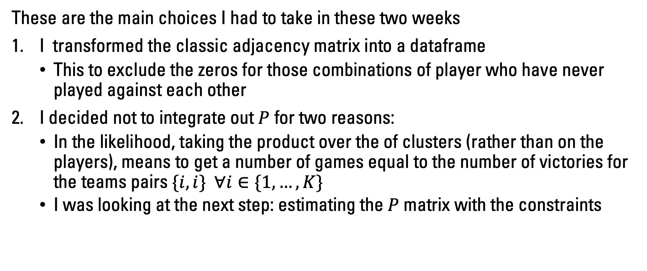
The “Simplified model file”
These are the main choices I had to take in these two weeks
I transformed the classic adjacency matrix into a dataframe
This to exclude the zeros for those combinations of player who have never played against each other
I decided not to integrate out $P$ for two reasons:
In the likelihood, taking the product over the of clusters (rather than on the players), means to get a number of games equal to the number of victories for the teams pairs $\{i,i\} ∀i∈\{1,…,K\}$
I was looking at the next step: estimating the $P$ matrix with the constraints

Slide 4
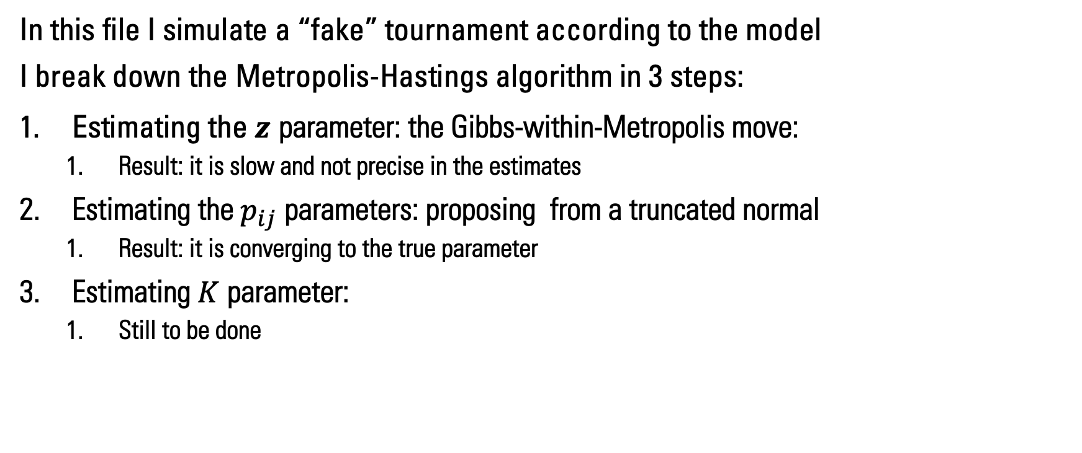
The “Simulation study file”
In this file I simulate a “fake” tournament according to the model
I break down the Metropolis-Hastings algorithm in 3 steps:
Estimating the $z$ parameter: the Gibbs-within-Metropolis move:
Result: it is slow and not precise in the estimates
Estimating the $p_{ij}$ parameters: proposing from a truncated normal
Result: it is converging to the true parameter
Estimating $K$ parameter:
Still to be done

Slide 5
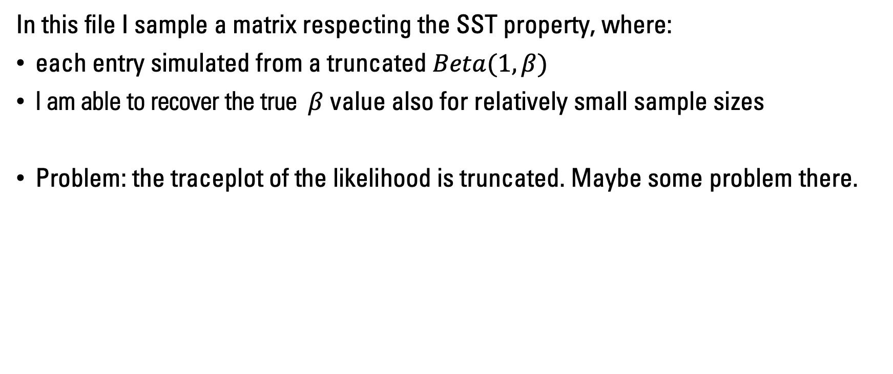
The “Prior file”
In this file I sample a matrix respecting the SST property, where:
each entry simulated from a truncated $Beta(1,β)$
I am able to recover the true $β$ value also for relatively small sample sizes
Problem: the traceplot of the likelihood is truncated. Maybe some problem there.

Slide 6
The “Functions_priorSST” file
This file contains auxiliary functions for the three other files
Probability computations
Data manipulation
Visualizations

Slide 7
Pros and Cons of the work done
Pros:
To estimate the ordered SBM I just have to replace the prior for beta.
The prior for beta is specified in the Prior file and tested
Also, letting K increase in this setting does not require major modifications
Cons:
Not very computational efficient
Still there is much testing to be done

Slide 8
Next steps:
Test the code for the Metropolis, in particular the last step and then put everything together
I want to avoid for-loops within the Metropolis code. I am planning to use left joint to speed up the process and make it more efficient.

